Slide 1


Water Demand Prediction Model
University of Utah MSBA Capstone Project
Spring 2022 Semester
Jackson Roper, Jake Thomas, Nate Hogenson, Zach McDougall
Notes:
Jackson

Slide 2

Business Problem
Jordan Valley Water Conservancy District (JVWCD) is seeking better efficiency with its resources
JVWCD wants to be more proactive instead of reactive to changing seasonal water demands
Reactivity to changing water demands can lead to long overtime hours and costly system changes
A more proactive approach would save money and manpower hours
Notes:
Jake

Slide 3


Analytics Solutions
Can demand be predicted based off of weather and seasonal trends?
Predictive Modeling
Regression Analysis – how does weather affect demand?
RStudio
Time Series Forecasting
Tableau
Notes:
Jake

Slide 4
Exploratory Data Analysis & Feature Engineering
RStudio
Notes:
Jake

Slide 5
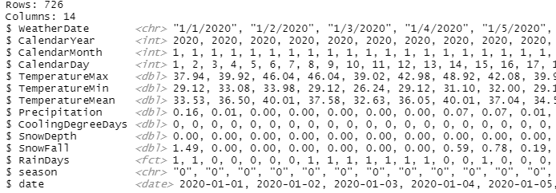
Weather Data from SLC International Airport
Notes:
Jake

Slide 6
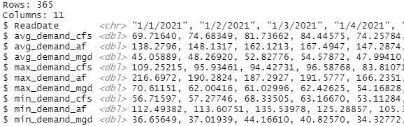

Jordan Valley Daily System Demand
Notes:
Jake

Slide 7
Correlation Analysis
Correlation to Average Demand (mgd)
Average temperature past 9 days | 0.9188635
Minimum Temperature | 0.8886672
Maximum Temperature | 0.8872000
Cooling Degree Days | 0.8236081
Snow Fall | -0.1394868
Average snow depth past 9 days | -0.2739662
Average precipitation past 9 days | -0.2474876
Notes:
SLIDE IS OPTIONAL
Update correlation plot with new data set; remove colors
Include old correlation plot
Data Dictionary needed for this slide. Business friendly variable names

Slide 8
Level Set
P-Value
P =< Alpha
We used Alpha = 0.05
R²
R² Interpretation:
> 90 % Very good
90 % - 80 % Good
80 % - 60 % OK
< 60 % Not good
White Box -vs- Black Box Modeling
Notes:
Nate

Slide 9
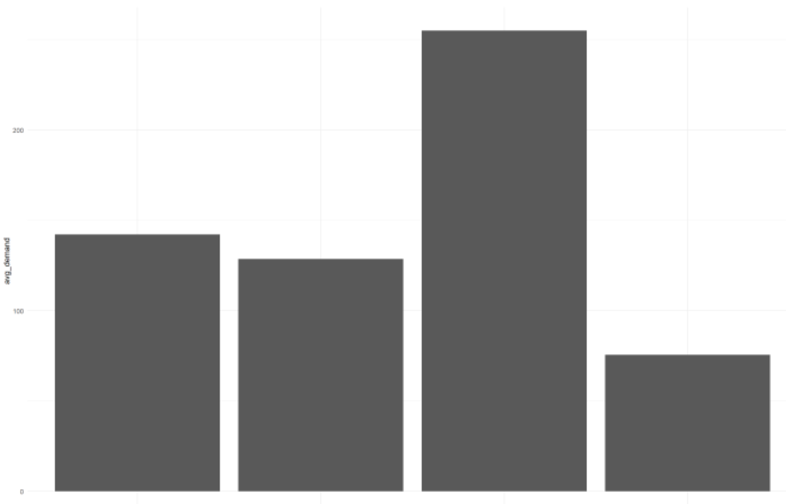
Season Variable
Demand by Season
Used calendar month to create this variable
Demand is highest during Summer season
Model without season variable: R² = 0.837
Model with season variable: R² = 0.849
Demand avg mgd
Fall Spring Summer Winter
* R-squared (R²): measures how well the regression model fits the observed data
Notes:
Nate

Slide 10
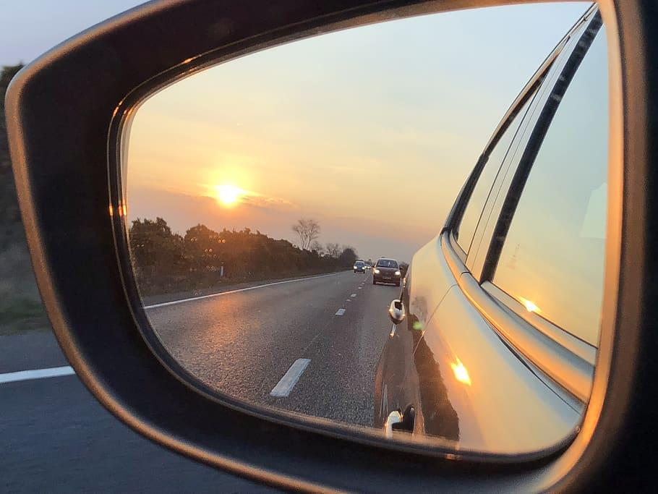
Lookback Averaged
We found that looking back a few days and averaging weather gave us a more accurate prediction
Notes:
Nate

Slide 11
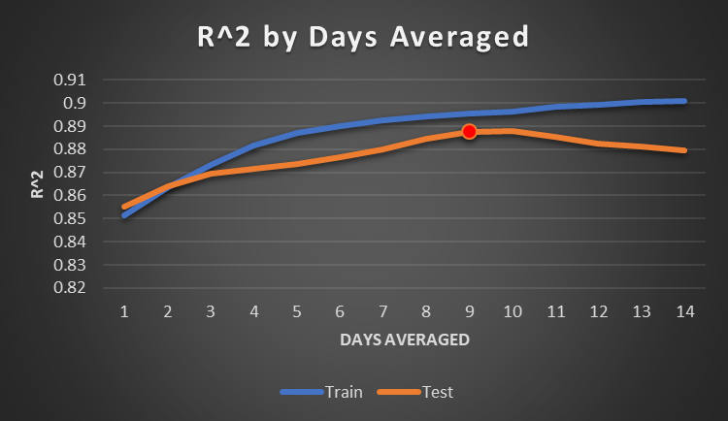
Averaged Lookback: Optimal Number of Days
We looked a multiple options to find the optimal number of lookback days to average
Train is the 80% split we used to train the model
Test was the 20% split we used to monitor overfitting
We chose to go with 9-10 days as that is showing the best results on the test dataset
Note: Removed Rain Days and Rainfall < 0.05 inches per JVWCD’s request. This did not affect model performance.
Notes:
Nate

Slide 12
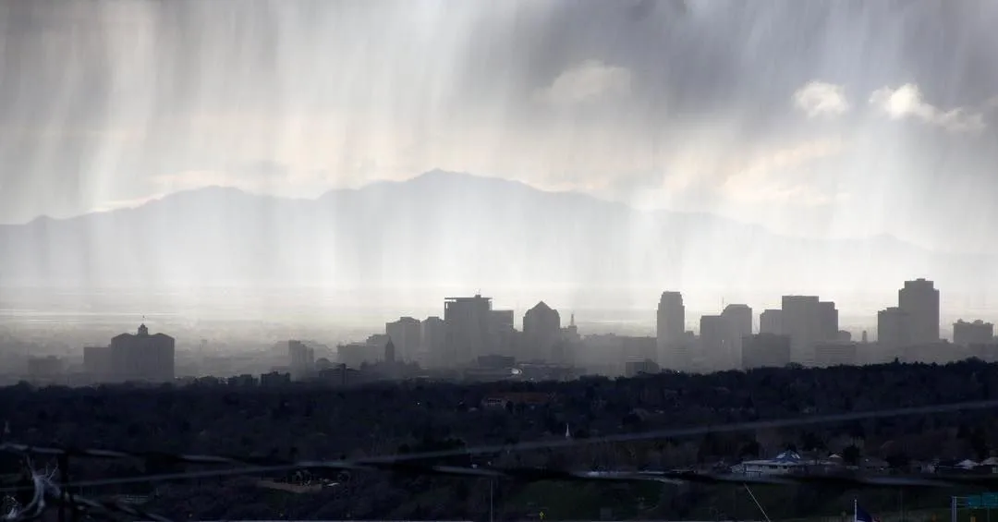
Precipitation 9 Day Lookback Averaged
Precipitation was surprisingly insignificant in initial model predictions with a P Value = 0.09
We used alpha of 0.05 to Benchmark
Averaging Precipitation over 9 days resulted in a P Value < 0.001
Note: Removed Rain Days and Rainfall < 0.05 inches per JVWCD’s request. This did not affect model performance.
Notes:
Nate

Slide 13
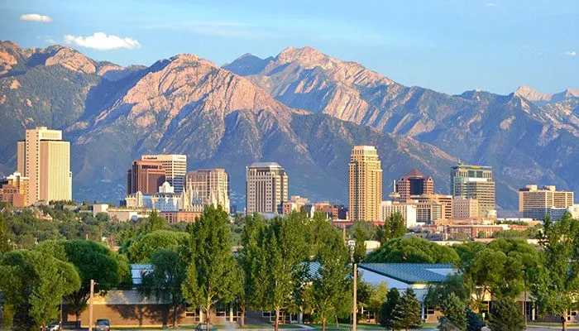
Temperature 9 Day Lookback Averaged
New variable taking previous 9 day average temperature
Standard Temp: R² = 0.85
9 Day Avg Temp: R² = 0.899
* R-squared (R²): measures how well the regression model fits the observed data
Notes:
Nate

Slide 14
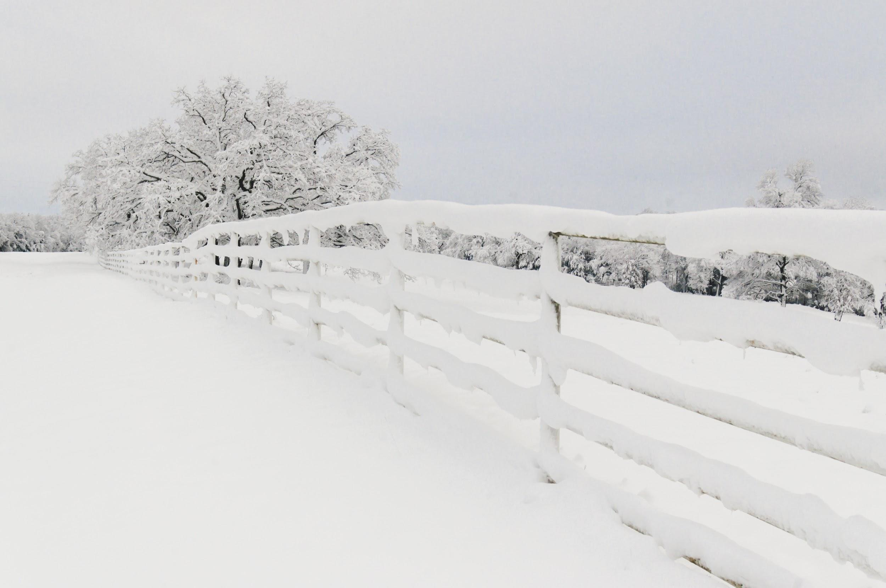
Snow Depth 9 Day Lookback Averaged
New variable taking a 9 previous day average of Snow Depth
Standard Snow Depth P Value = 2.14e-07
9 Day Avg Snow Depth P Value = 4.66e-10
* R-squared (R²): measures how well the regression model fits the observed data
Notes:
Nate
Snow Depth doesn’t have as much predictive power because water demands aren’t as driven by weather variables in the wintertime when snow is on the ground.

Slide 15
Predictive Modeling
RStudio
Notes:
Jake

Slide 16
Model Selection
Predictions
Per sponsor request Average Million Gallons Per Day is our target variable.
We explored multiple predictive models. Our 3 favorites are:
Linear Regression
K Nearest Neighbors
Tableau
Notes:
Jackson

Slide 17
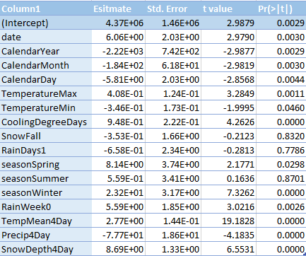
Linear Regression (White Box)
Estimate
Notes:
Jake
What to do with coefficients

Slide 18

K Nearest Neighbors (kNN) Modeling (Black Box)
An algorithm that comes from real life
The value of a data point is determined by the data points surrounding it
kNN regression takes the mean value of k closest points to make predictions
k = 34 and I = TRUE provided us the best results
Image Source
Notes:
Jackson

Slide 19
Additional Performance Metrics
MAE: Tells us the average absolute value of the difference between our models predicted value and the demand actual value for each day.
RMSE: Tells us the average deviation between the predicted demand made by the model and the actual demand value.
MAPE: Returns error as a percentage, making it easy to interpret:
MAPE Interpretation:
< 10 % Very good
10 % - 20 % Good
20 % - 50 % OK
> 50 % Not good
Indicates model improves as this metric increases
Indicates model improves as this metric decreases
Notes:
Zach
Explain R2 values….maybe dedicate a whole slide to R2 values. Choose the easiest metric to understand. Get JV on board with model outputs
BIG FONT SIZE FOR IMPORTANT NUMBERS.

Slide 20
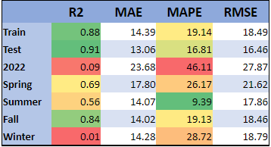
Winter Performance
We noticed model performance was bad on Winter and 2022 data.
This would suggest that weather is not the driver of demand during the winter months.
Indicates model improves as this metric increases
Indicates model improves as this metric decreases
Notes:
Zach

Slide 21
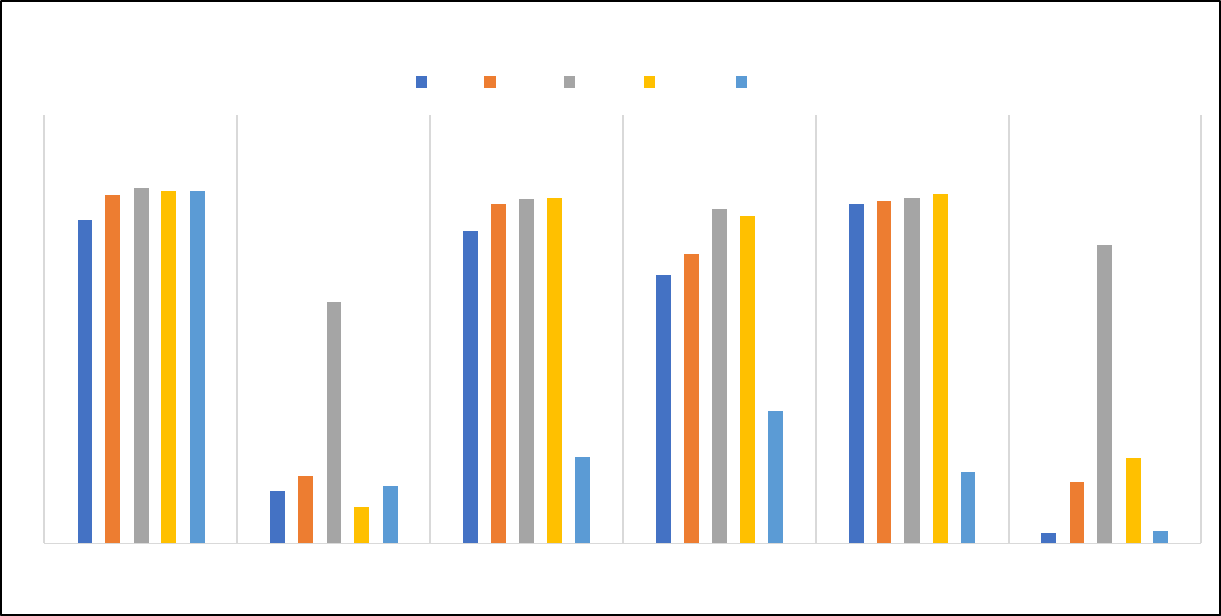
* R-squared (R²): measures how well the regression model fits the observed data on a scale of 0-1. (1 being a perfect fit)
Notes:
Zach
Rework this slides with updated modeling results

Slide 22
KNN Model Validation
We split our data 80/20
We used our 20% test set to see how the model might perform on new data
Model | R2 | MAE | MAPE | RMSE
Train Dataset | 0.996 | 2.59 | 3.16 | 3.59
Test Dataset | 0.922 | 10.60 | 13.43 | 14.87
Indicates model improves as this metric increases
Indicates model improves as this metric decreases
Notes:
Zach
MIght be a little much to digest with the various metrics

Slide 23
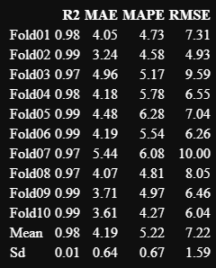
KNN 10 Fold Cross Validation
Indicates model improves as this metric increases
Indicates model improves as this metric decreases
Notes:
Zach

Slide 24
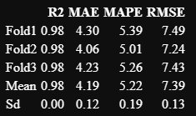
KNN 3 Fold Cross Validation on Winter Data
Indicates model improves as this metric increases
Indicates model improves as this metric decreases
Notes:
Zach

Slide 25
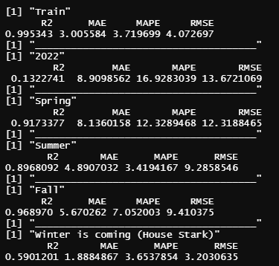
KNN Model Trained Without 2022 Data
When you train the Model with only 2020 and 2021 Data Performance is worse.
Clifton mentioned 2022 will be difficult to predict due to water conservation efforts.
Winter Performance is still the best with KNN.
Indicates model improves as this metric increases
Indicates model improves as this metric decreases
Notes:
Zach

Slide 26
Time Series Forecasting
Tableau
Notes:
Jackson

Slide 27
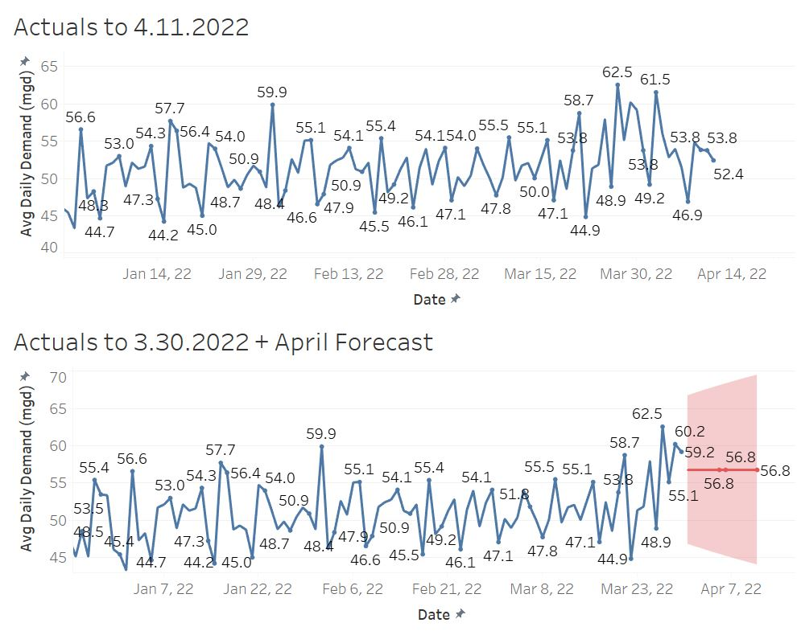
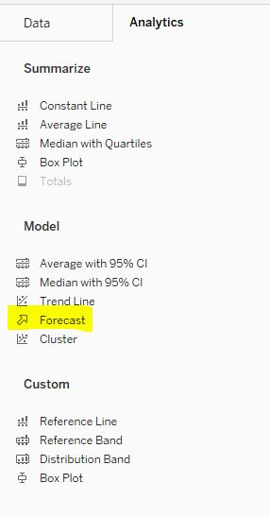
Notes:
Add in hourly forecast

Slide 28
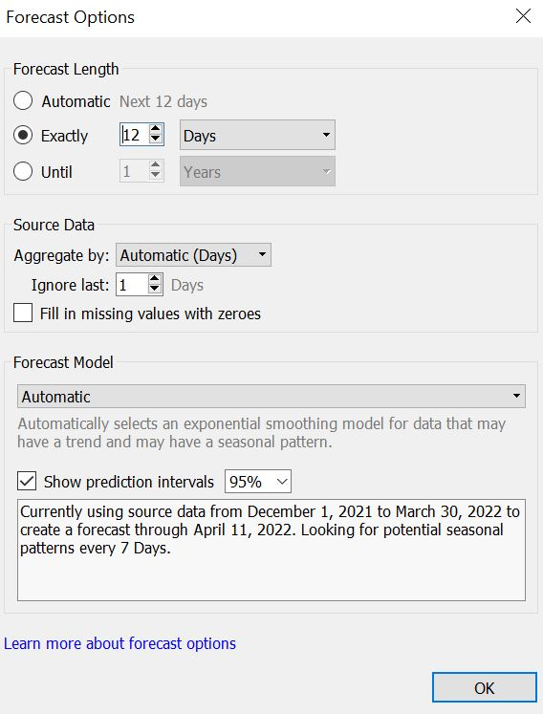
Notes:
Jackson

Slide 29
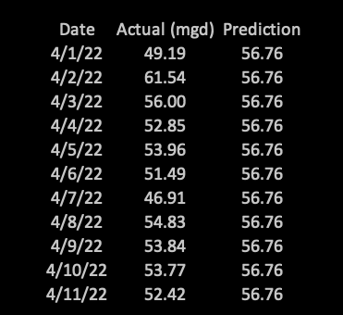
Tableau Model Performance
RMSE: 5.1
MAE: 3.8
MAPE: 7.4%
Indicates model improves as this metric increases
Indicates model improves as this metric decreases
Notes:
Jackson

Slide 30

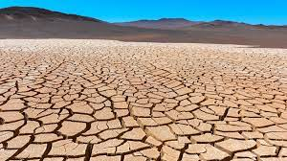
2022 Challenges
Notes:
Nate
Open for discussion gov cox declares state of emergency, government messaging with drought situation
Openweathermap.org
Possibly working with another Capstone group
Hoover dam?

Slide 31
Questions?
Notes:
Does JV work a ton of OT in the wintertime?

